Slide 1
Entity Framework Code First
王致平 Eric Ping

Slide 2
What is Code First?

Slide 3
We don’t need to create DB by ourselves.

Slide 4
Create DB Schema by Code-Generated

Slide 5
You won’t need to worry about anything with SQL

Slide 6
Focusing on OO Programming and Structure Design

Slide 7
Let’s start with it

Slide 8
After creating a project

Slide 9
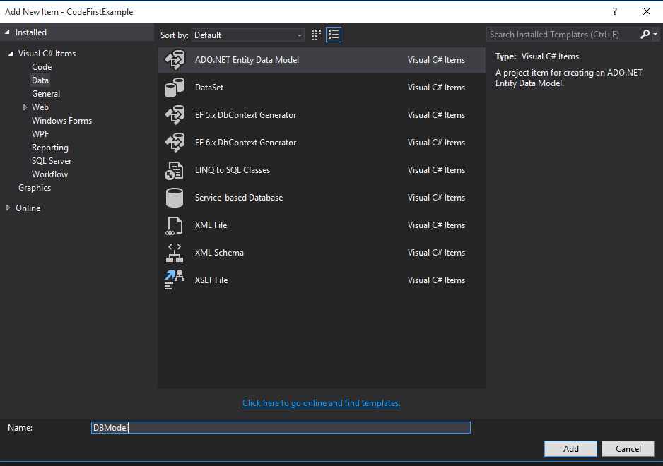
Add New Item

Slide 10
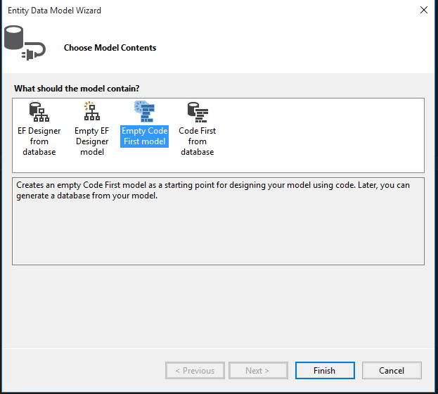
Add New Item

Slide 11
Creating a new file named "_BaseModel.cs"

Slide 12
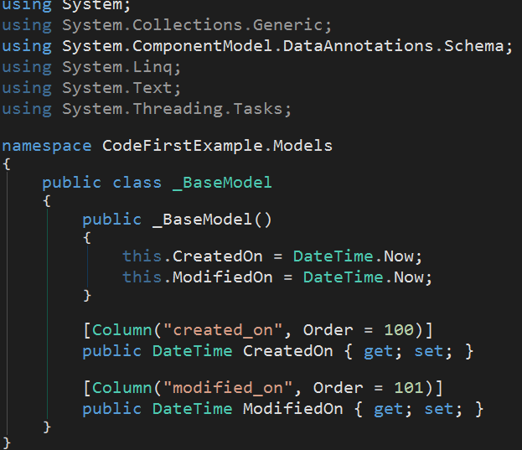
_BaseModel.cs

Slide 13
Creating a new file named "Article.cs"

Slide 14
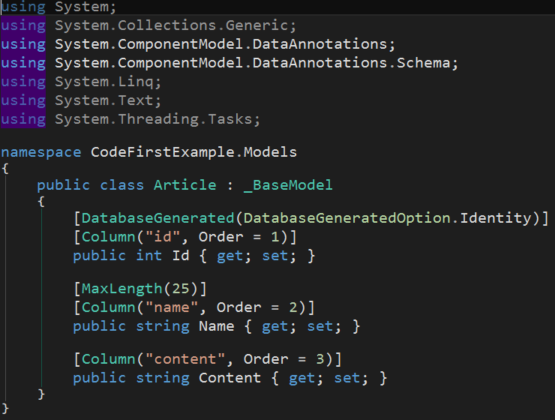
Article.cs

Slide 15
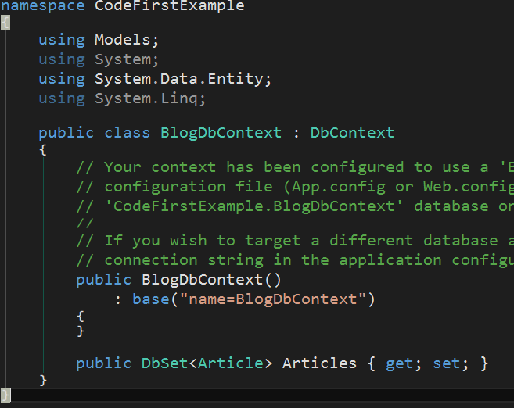
BlogDbContext.cs

Slide 16
1. Column 2. MaxLength, MinLength 3. Required 4. DatabaseGenerated

Slide 17
"Column" Attribute can define the real column Name, Order, Type in database

Slide 18
"MaxLength" Attribute specifies Max Length for a column of type string Same as StringLength Attribute

Slide 19
"MinLength" Attribute specifies Min Length for a column of type string

Slide 20
"Required" Attribute specifies that the value called by string.IsNullOrWhiteSpace must return false

Slide 21
Initial Database with Code First

Slide 22
1. DatabaseInitializer 2. Use Empty Database 3. Use Existing Database 4. Change Schema 5. Automatic Migration

Slide 23
DatabaseInitializer
• CreateDatabaseIfNotExists
• DropCreateDatabaseIfModelChanges
• DropCreateDatabaseAlways

Slide 24
Use Empty Database
Just Click Ctrl + F5

Slide 25
Use Existing Database
1. Enable-Migrations
2. Add-Migration InitialCreate –IgnoreChanges
3. Update-Database

Slide 26
Automatic Migration
• Add-Migration [Name] • Update-Database
Or
• Update-Database –Script ➔ Generate SQL

Slide 27
Change Schema
• Enable-Migrations –EnableAutomaticMigrations
• Update-Database or Update-Database -Script

Slide 28
It's Show Time!!!

Slide 29
Thank You

